Slide 1
Efficient Data Collection

Slide 3
Effort now saves time, money, & stress later.

Slide 4
Efficient Data Collection

Slide 5
Paperless Data Collection

Slide 6
How can we be more efficient?
To answer that question…we ask another one:
Where can errors be introduced?

Slide 7
How can we be more efficient?
Data (Re)organization
Project
Planning
Data Collection
Data
Entry
Data
Correction
Data Organizing for Analysis
Data Analysis
More Data Correction

Slide 8

Where can errors be introduced?
Data (Re)organization
Project
Planning
Data Collection
Data
Entry
Data
Correction
Data Organizing for Analysis
Data Analysis
More Data Correction

Slide 9


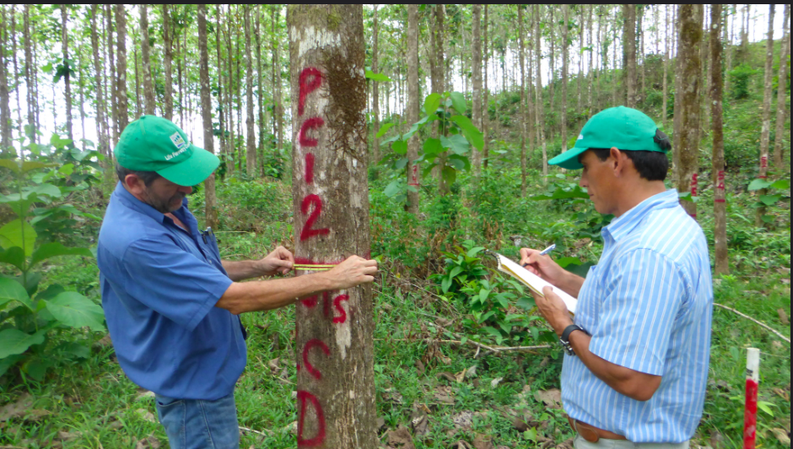

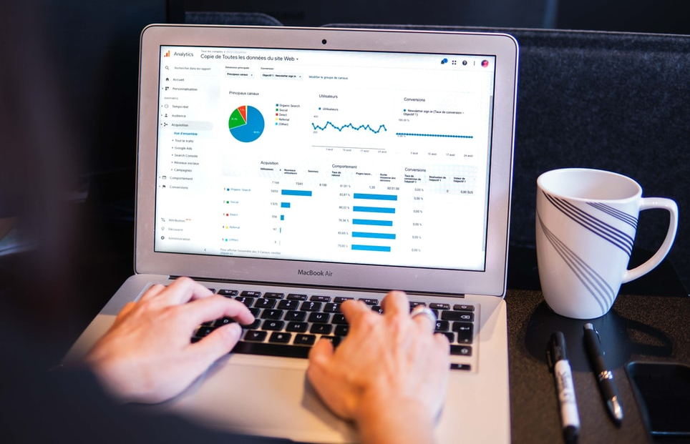
How can we minimize them?
Observe
Type data into spreadsheet or document
Write on paper
Hear

Slide 10
How can we minimize them?
Observe
Type data into spreadsheet or document
Write on paper
Hear

Slide 11
How can we minimize them?
Observe
Type data into spreadsheet or document
Write on paper
Hear

Slide 12
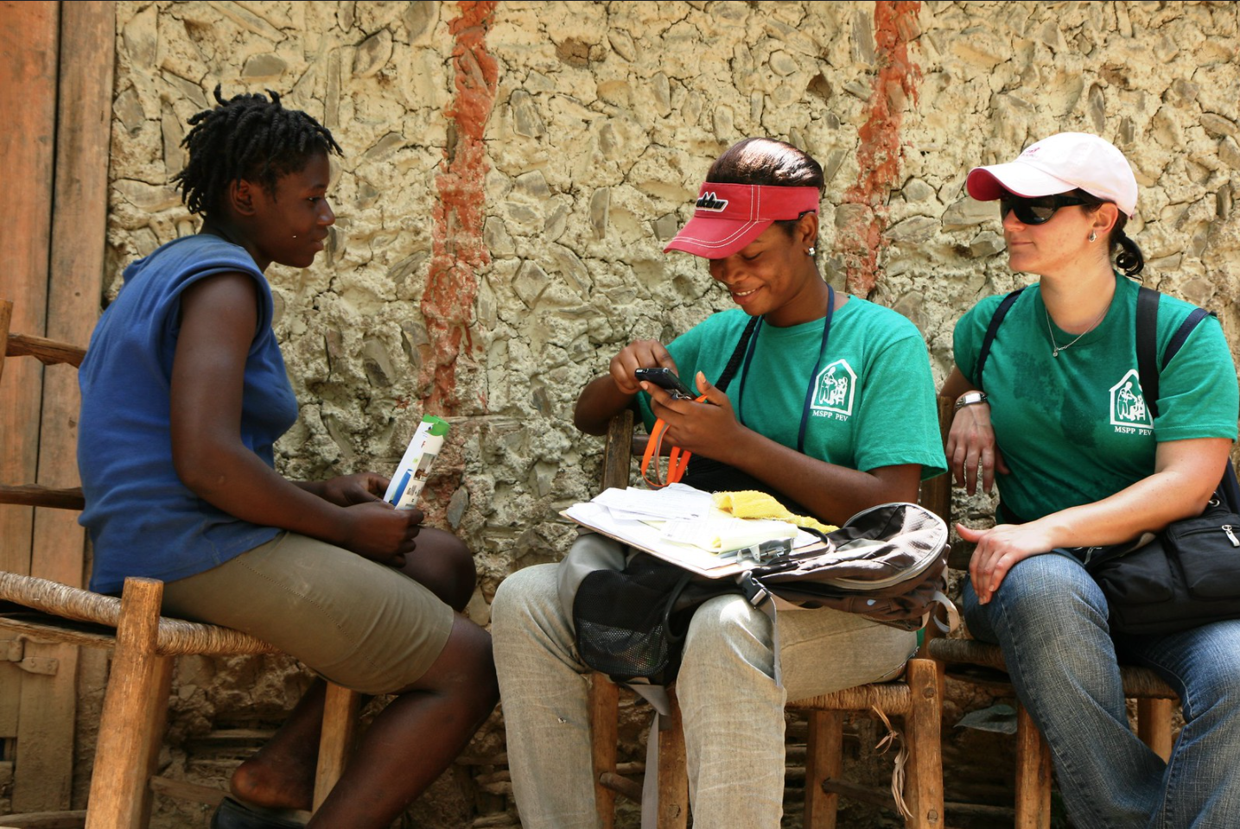


Slide 13




X

Slide 14
Why we should we all move to electronic data collection.

Slide 15
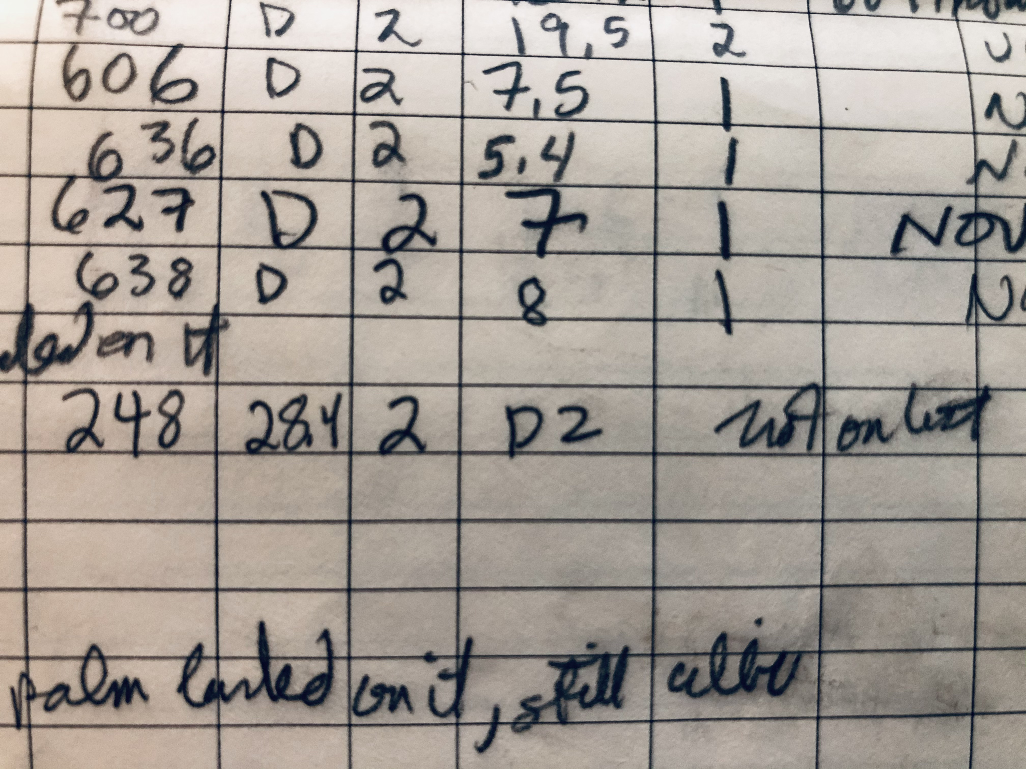
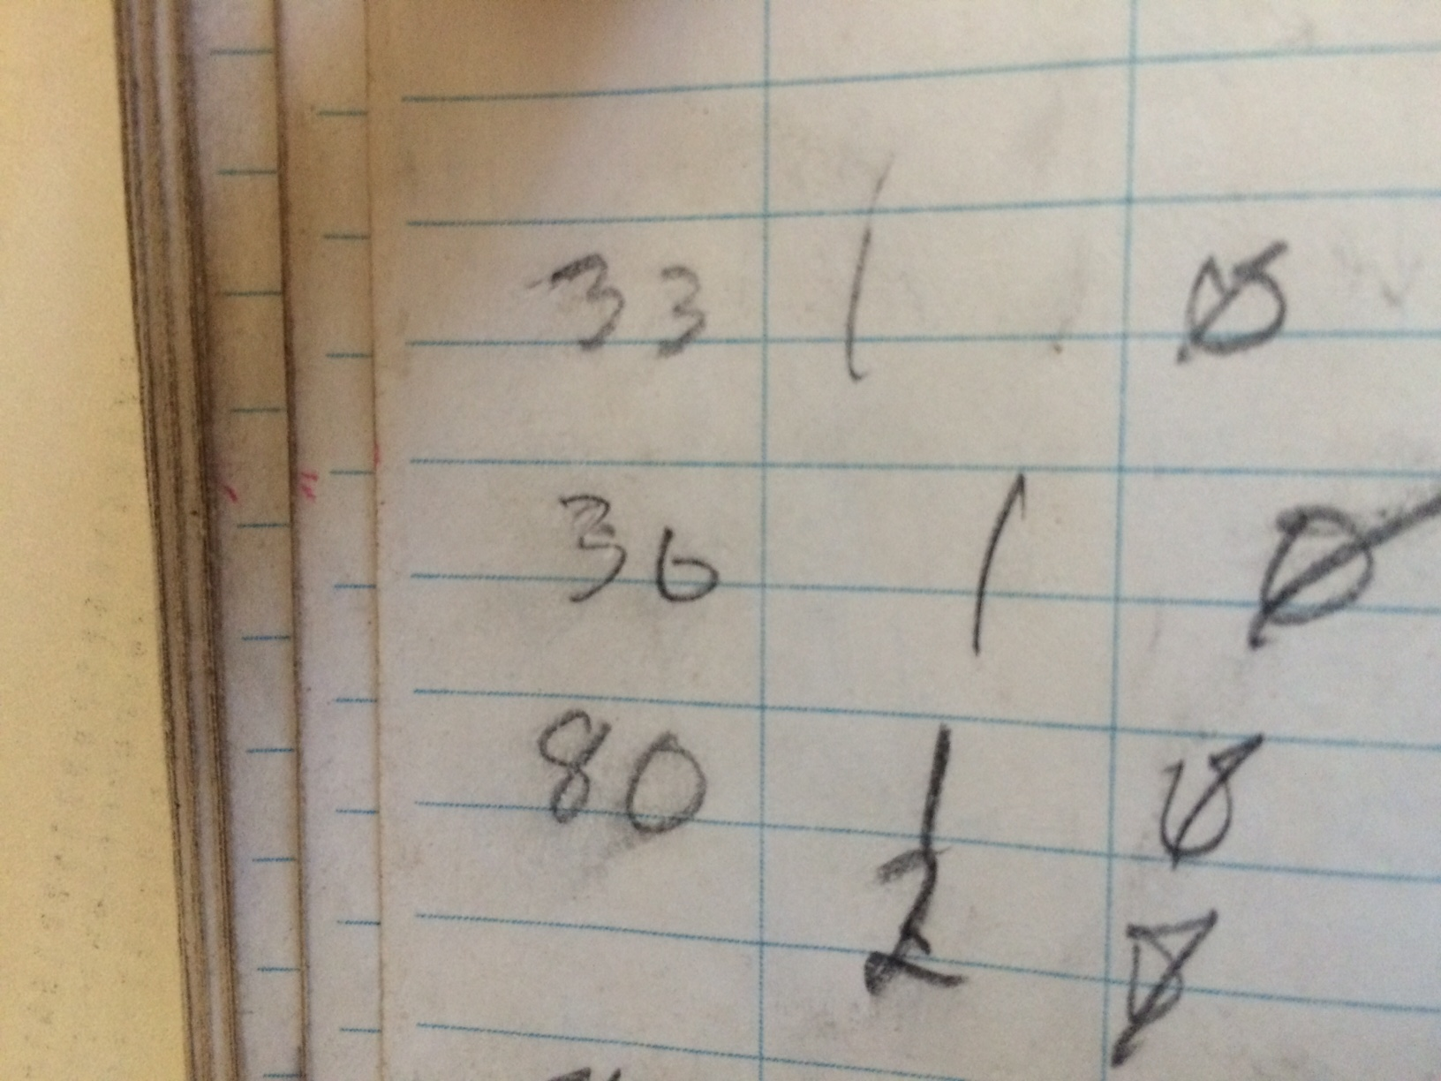
Data Quality & Error Reduction
Limit entries to valid values
Can ensure all required data are collected
Eliminates “accidental” entry errors or errors due to guesses
Zero or Six?
Uhhhh….any guesses?
“Not on list”
Translations: “palm landed on it, still alive.”

Slide 16
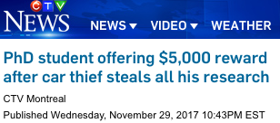
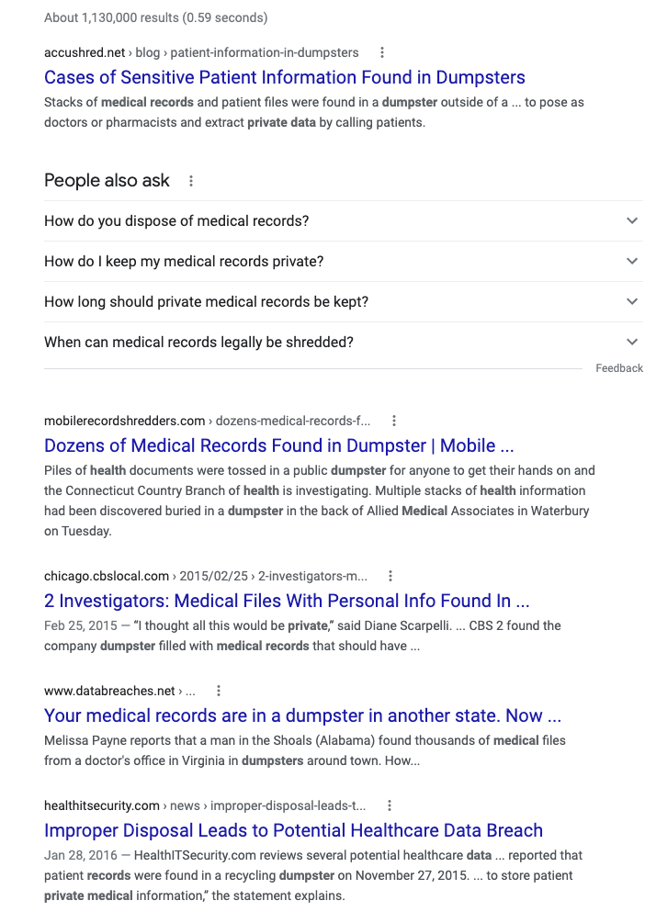
Storage and Security
Privacy
Loss

Slide 17
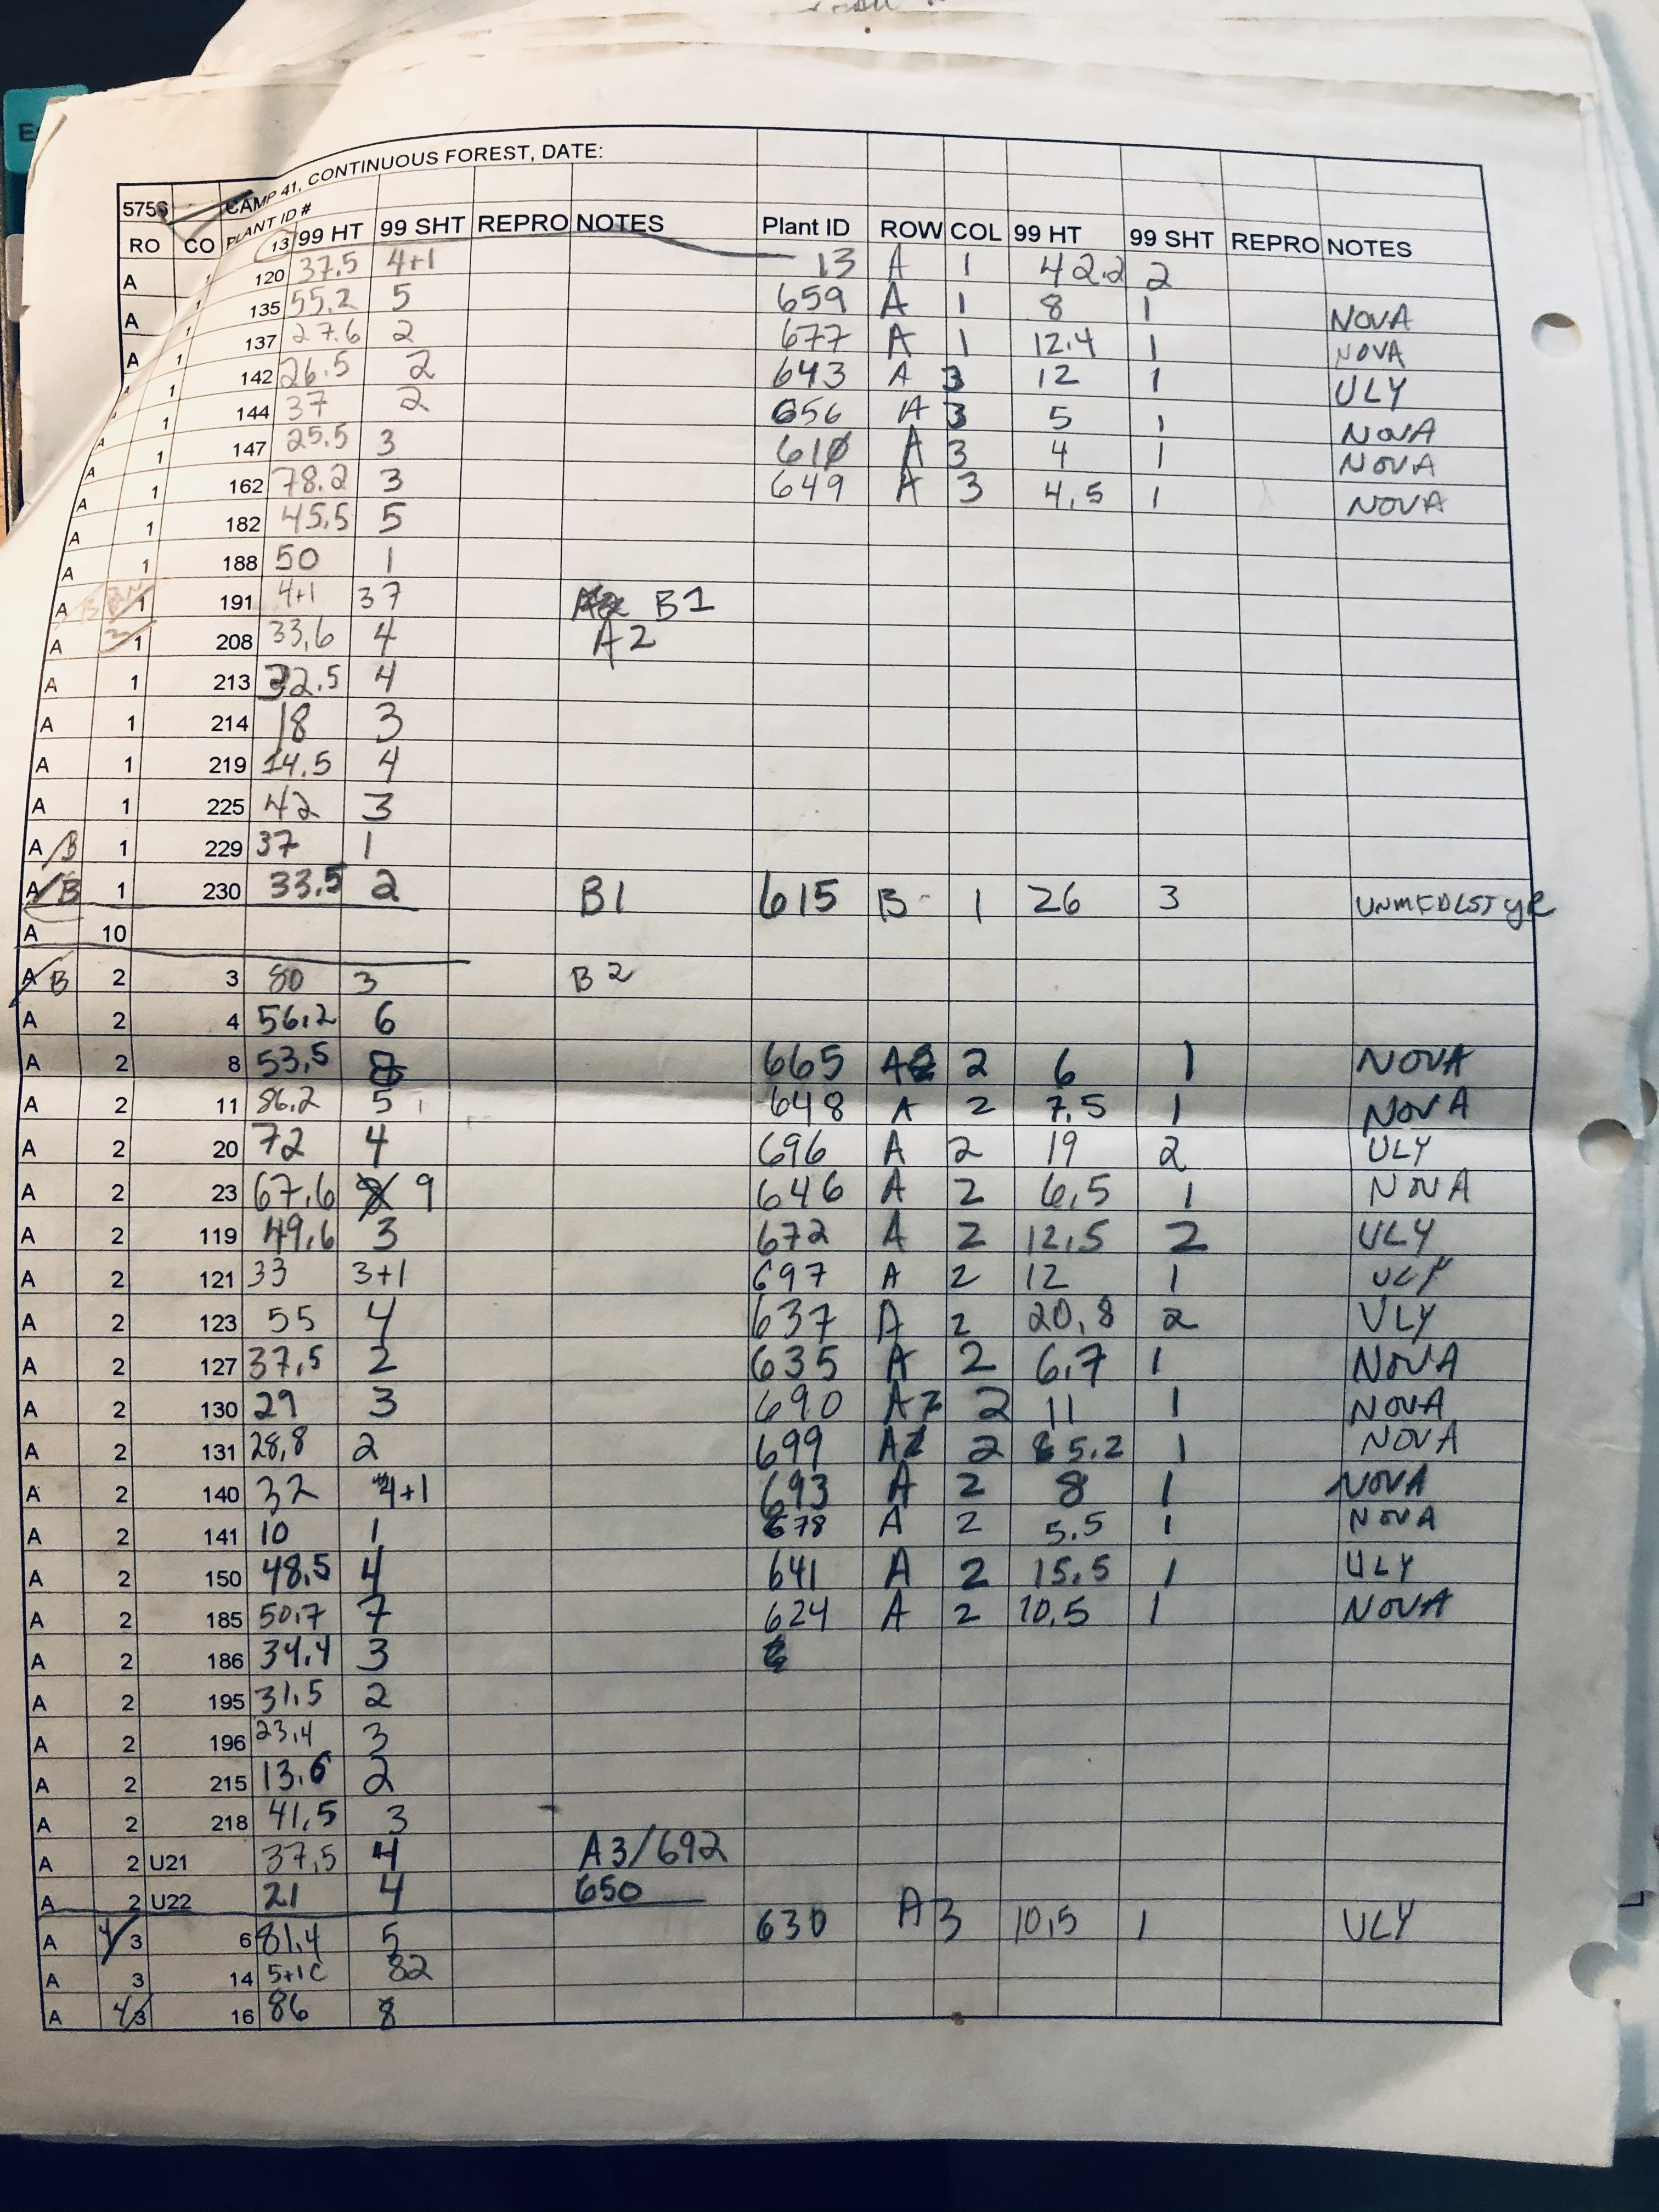
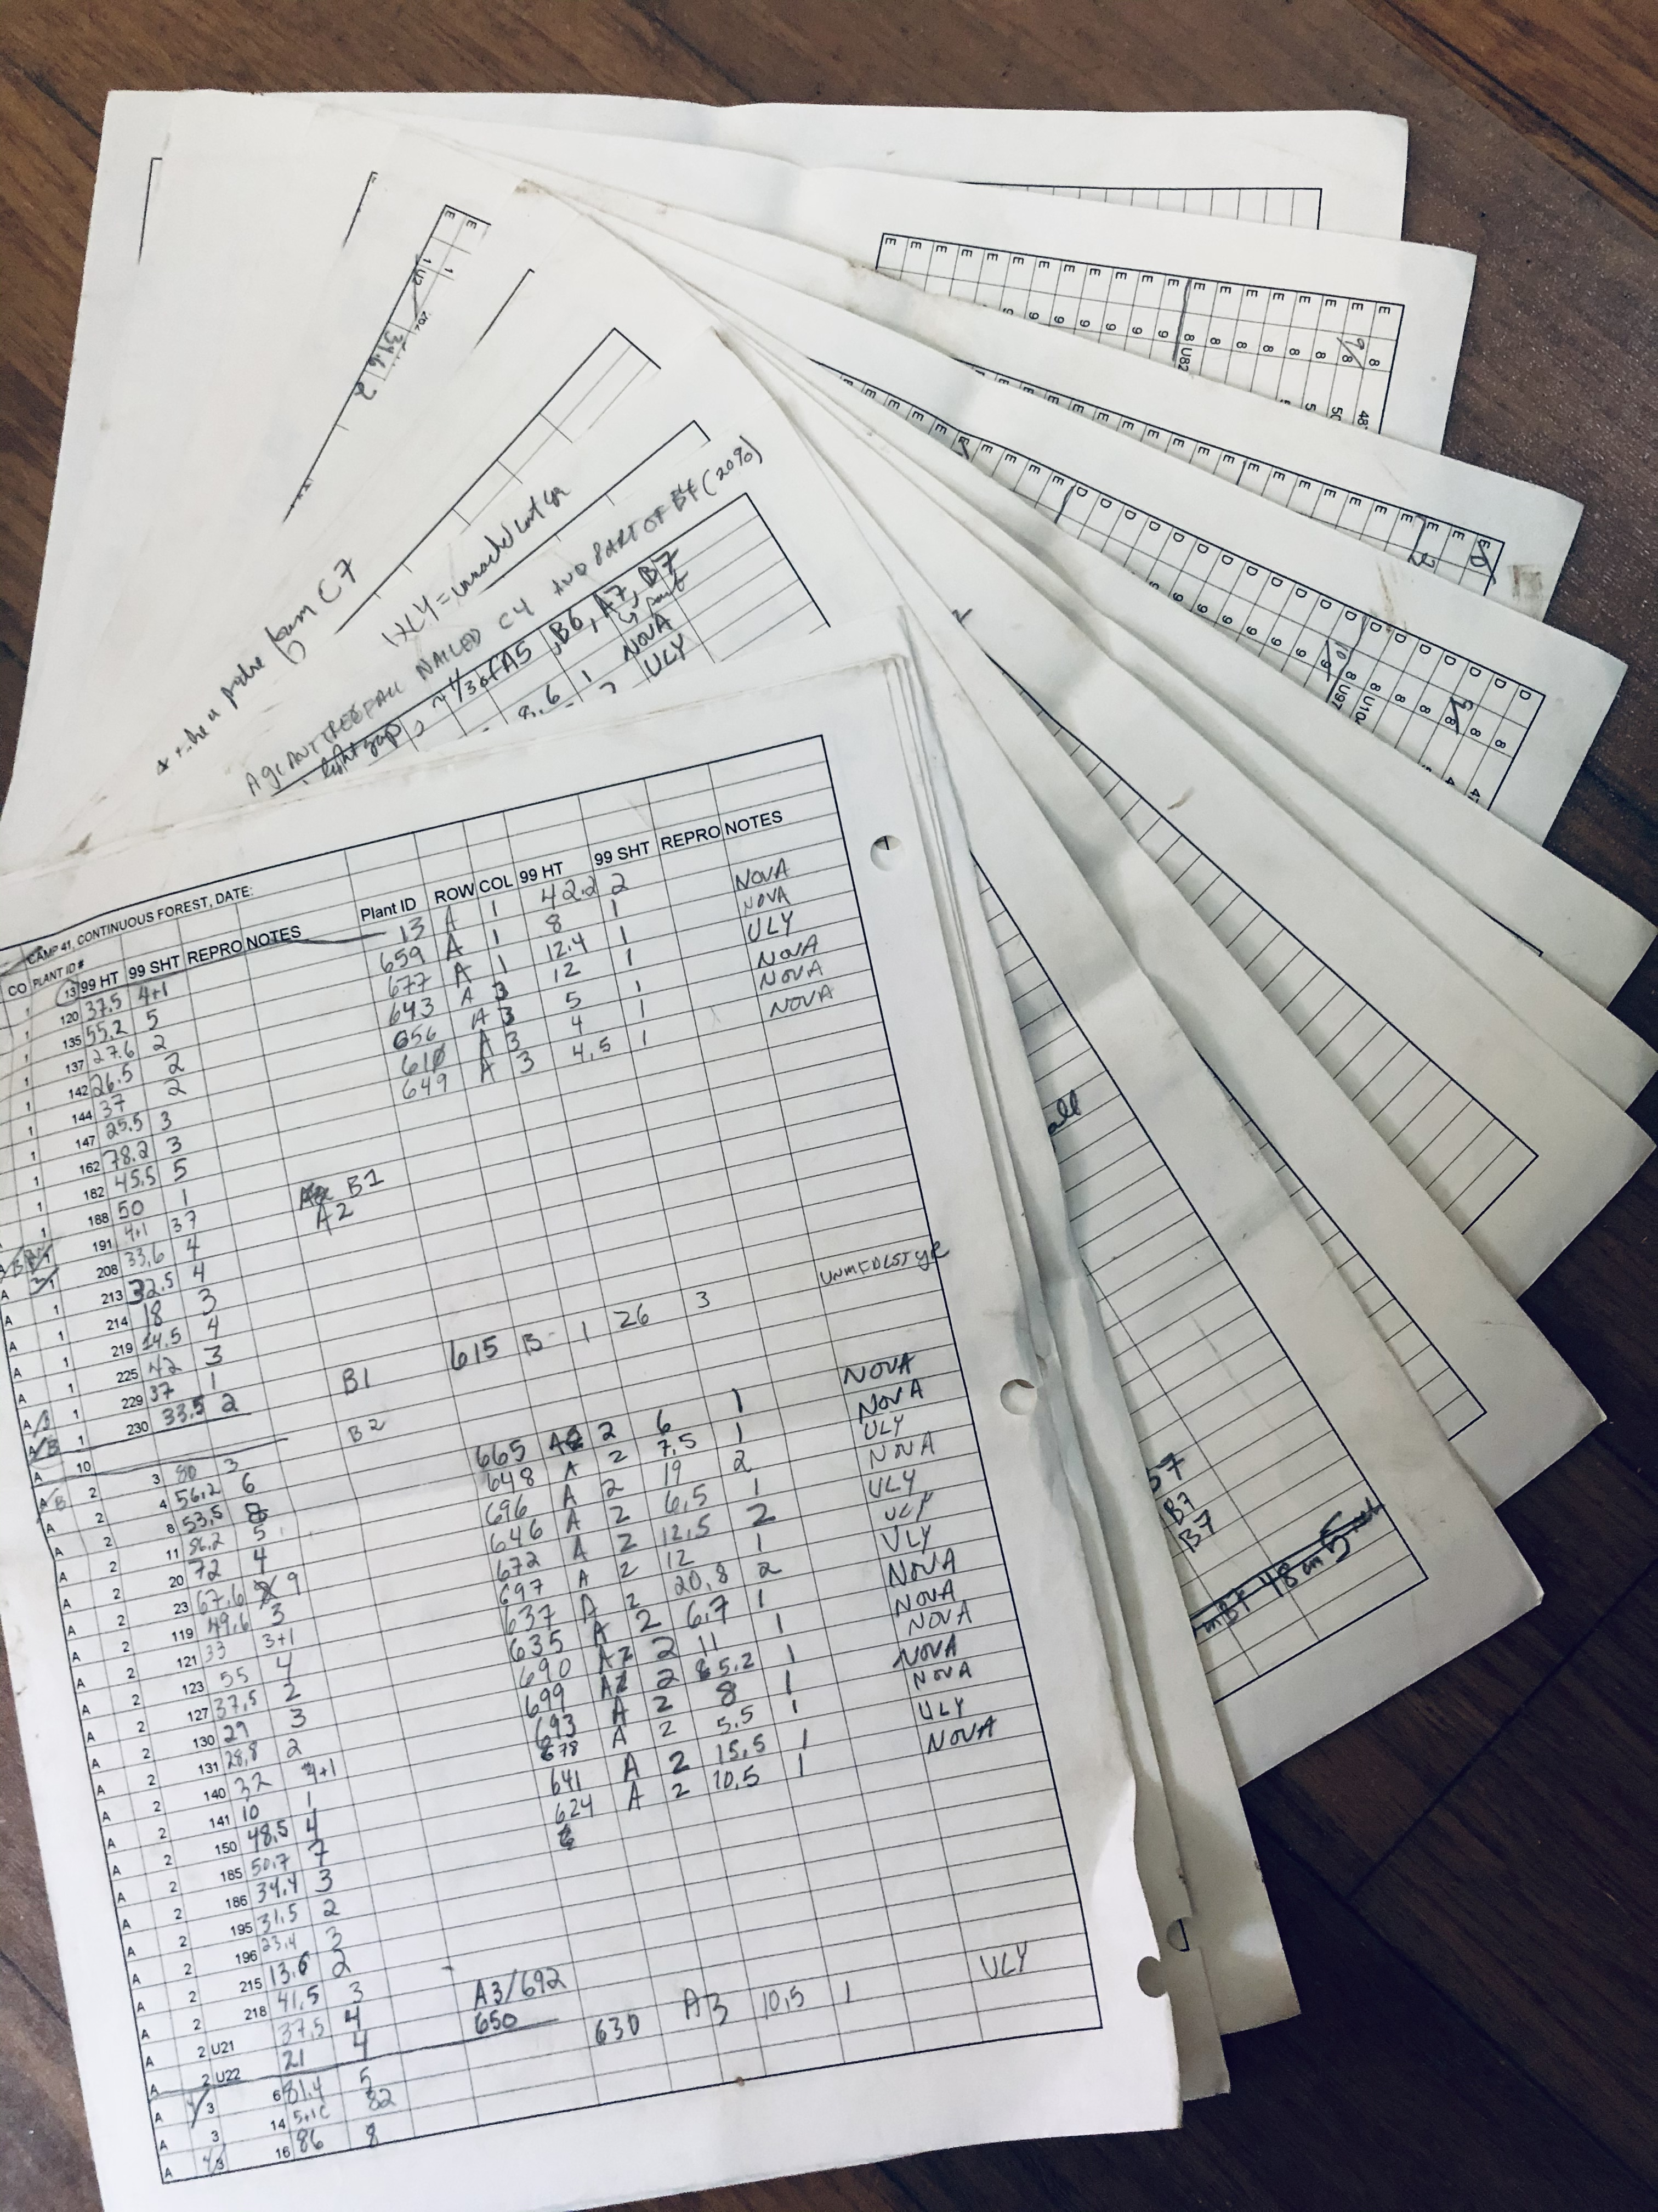
TIME SAVED
Survey Data
This sheet: (44 x 4) + (7 x 23) = 337 pieces of data
This location: 12 sheets
(some with up to 500 pieces of data recorded)
This study:
13 locations per year
Study duration: 10 years

Slide 18
Are there any shortcomings?
Screen size limits the ability to see multiple questions or quickly go back and forth
Gathering data may take longer (though still far less than data entering & cleaning)
Takes practice, pretesting, and more effort to set up forms
Battery life & availability of power sources
Backing up when there is no / slow / unreliable internet or cell service
Cost

Slide 19
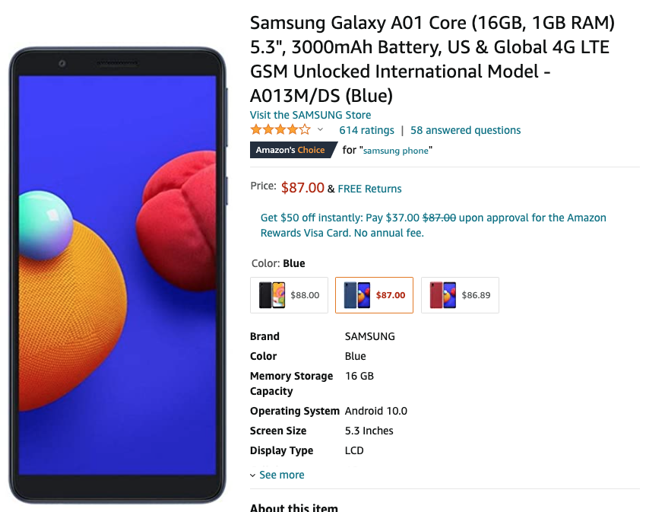
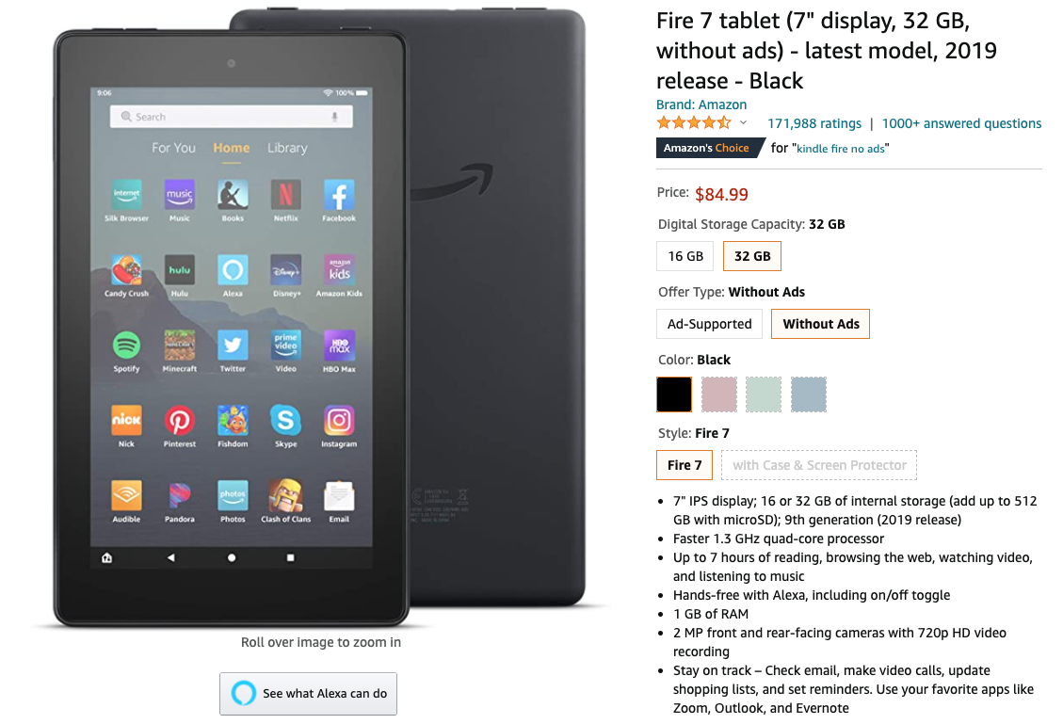

Slide 20
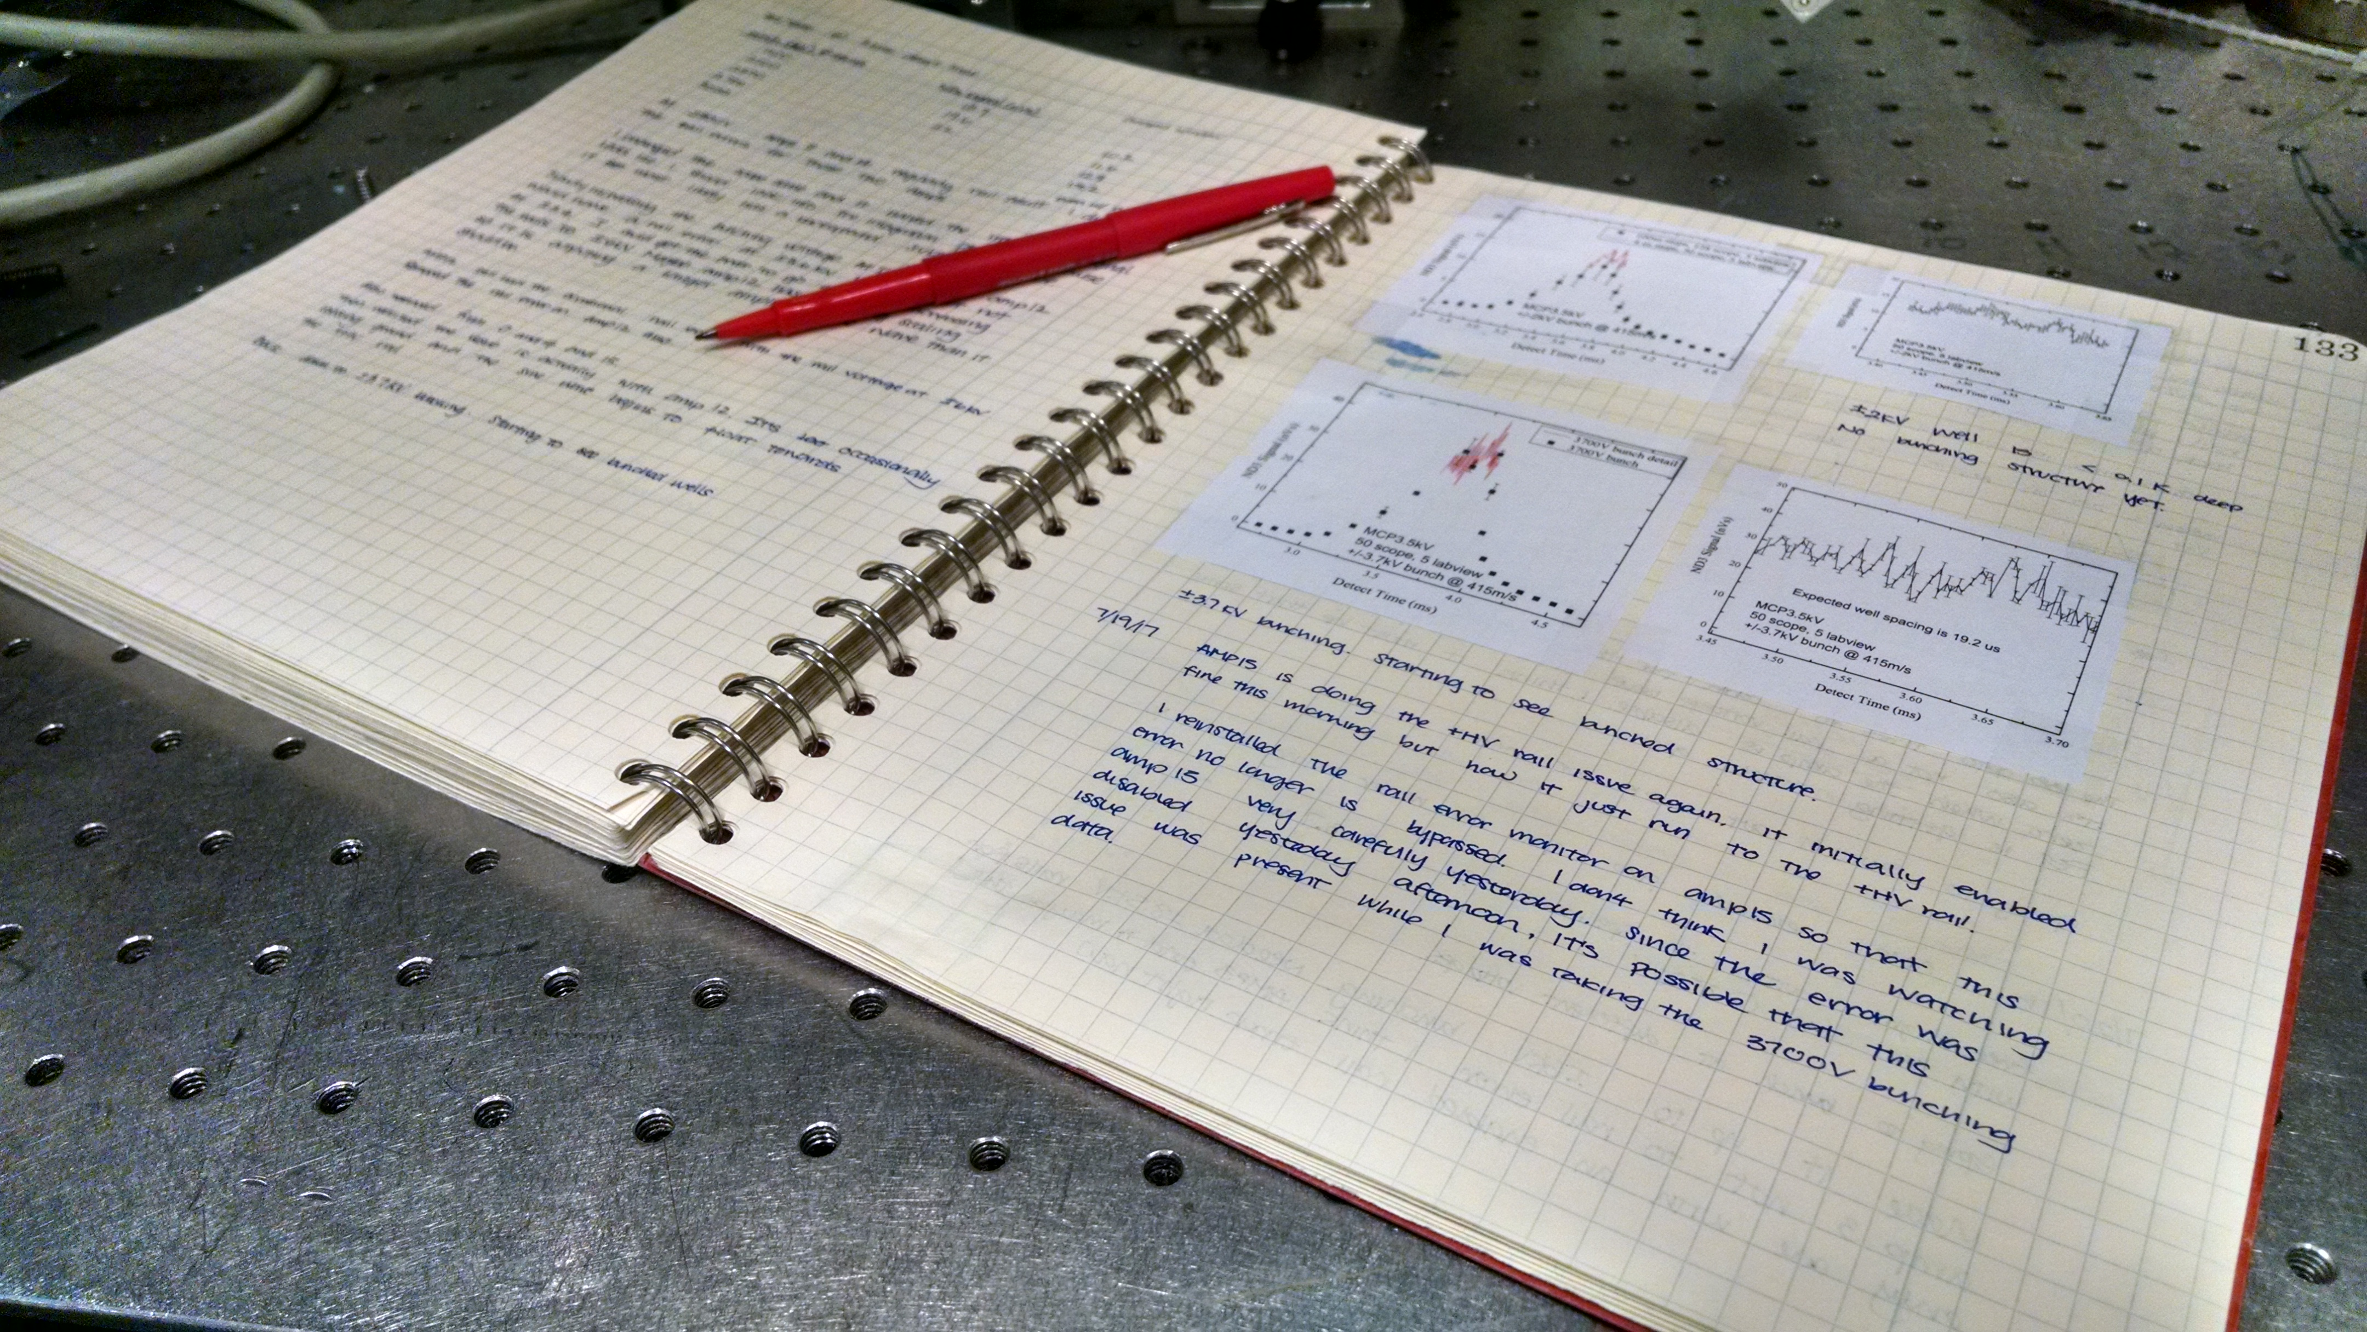
But I don’t work in the field…
I do lab / office / computer-based research!
Photo: https://jila.colorado.edu/lewandowski/research/scientific-communication-notebook-documentation

Slide 21
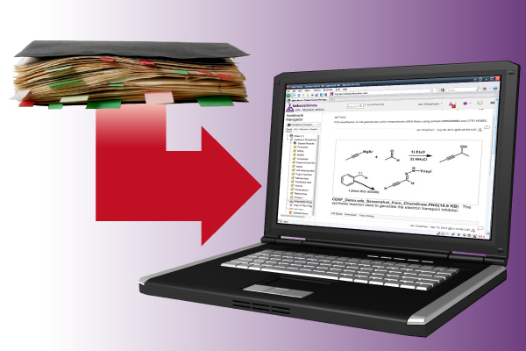
ELN: Electronic Lab Notebooks
Photo illustration: Troy Slama/DoIT (link to original)

Slide 22

